Slide 1

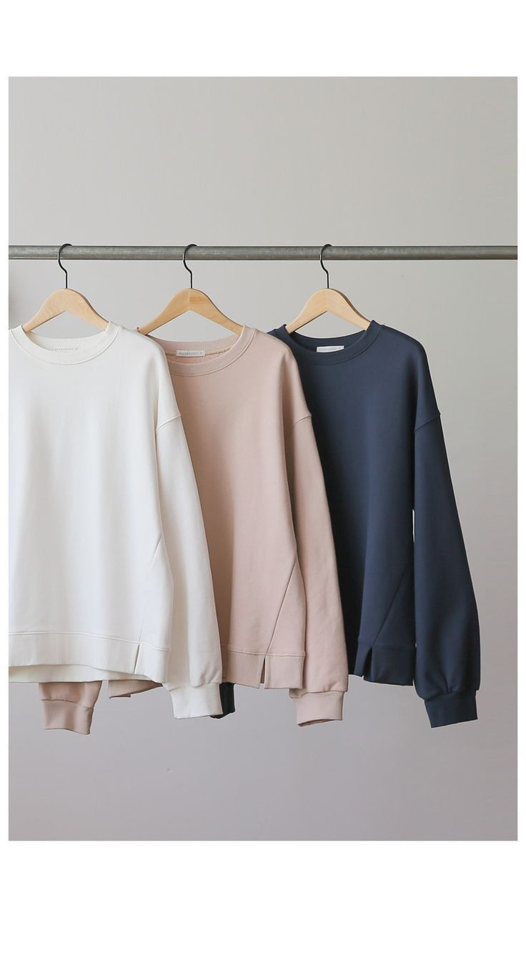
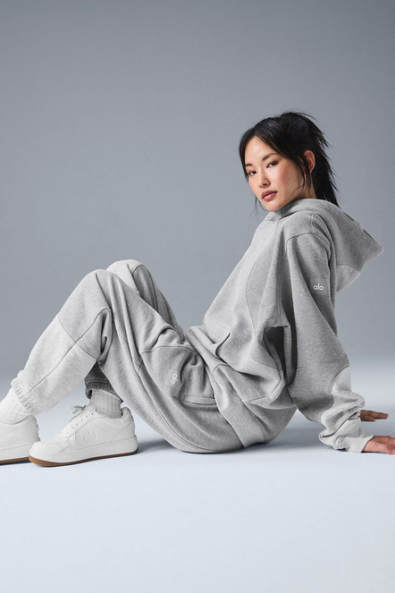
Everyday Style Reinvented
Clothing Presentation
@stylesaura
Presented By:
Harsh Shakya

Slide 2
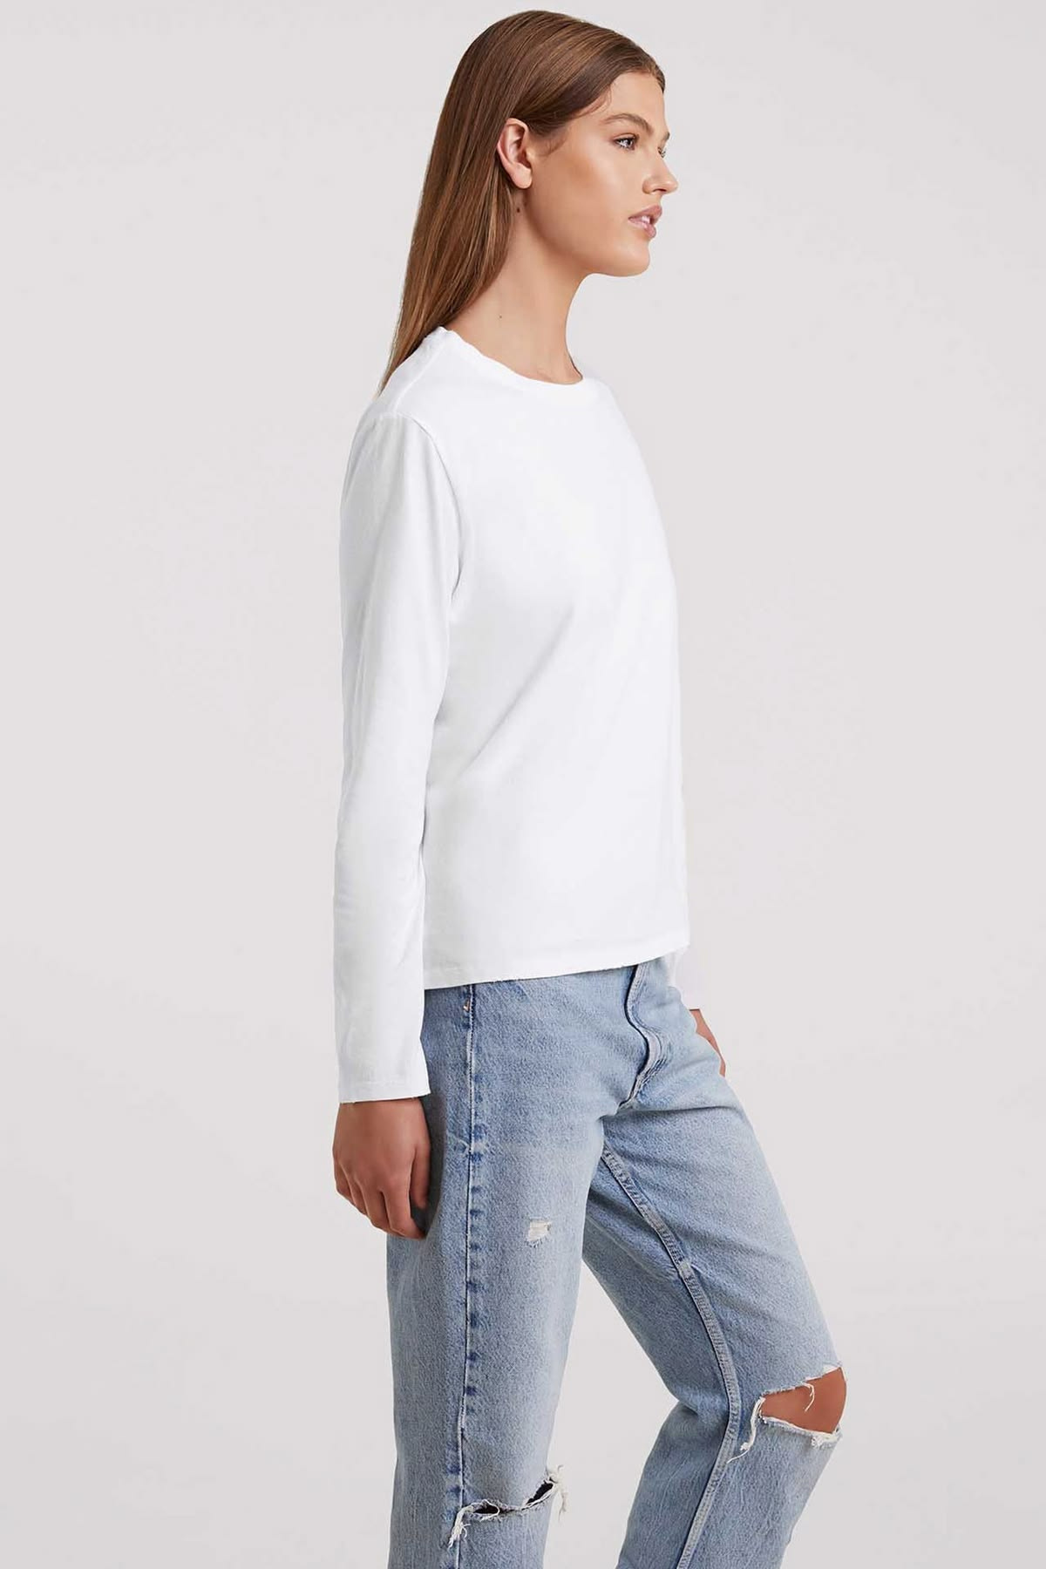

Understanding Everyday Needs
Wearer Insights
Consumers are in search of clothing that not only complements their daily routines but also boosts their confidence and promotes a sense of balance.

Slide 3

Defining a Modern Look
Elegant Simplicity
Clear Silhouettes
Subtle Textures
Neutral Balance
Simple silhouettes offer a refined look while demanding minimal effort.
Light fabrics bring subtle intrigue to outfits while maintaining a polished appearance.
A harmonious color palette enables items to seamlessly integrate with current wardrobes.
@stylesaura

Slide 4
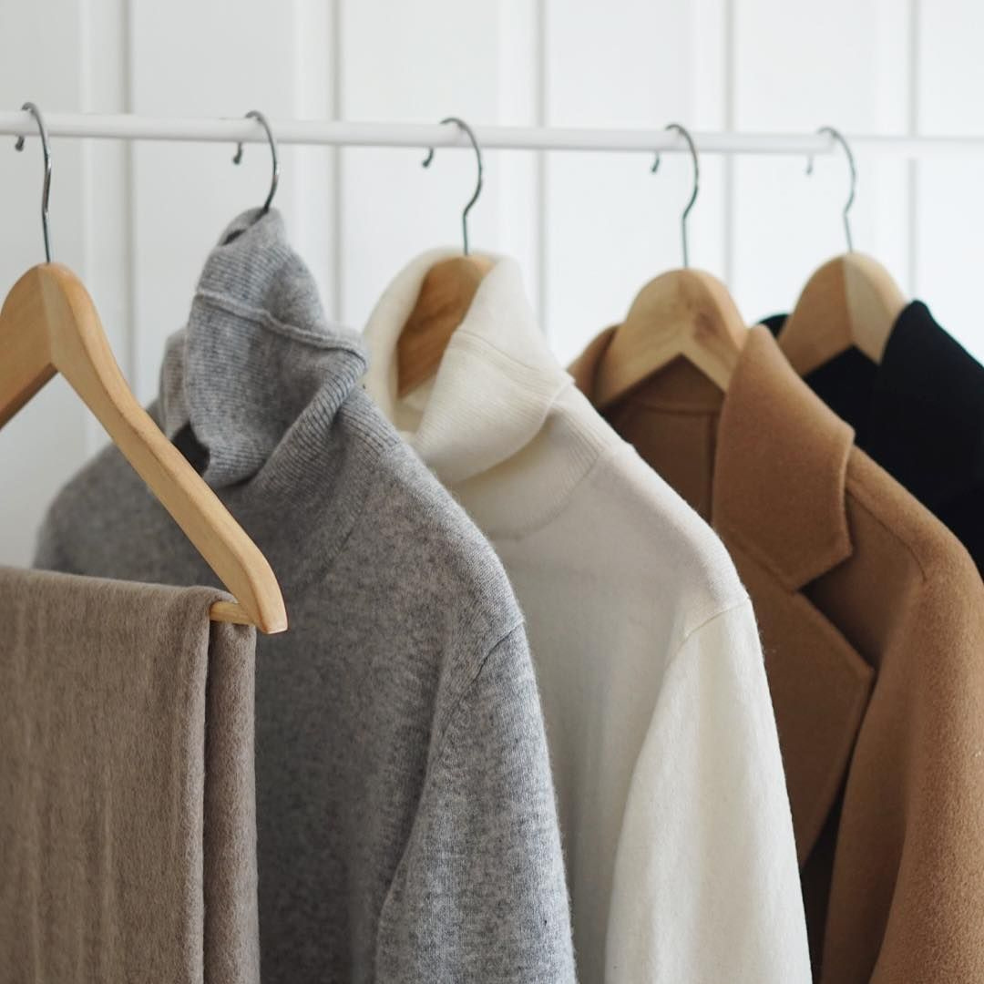

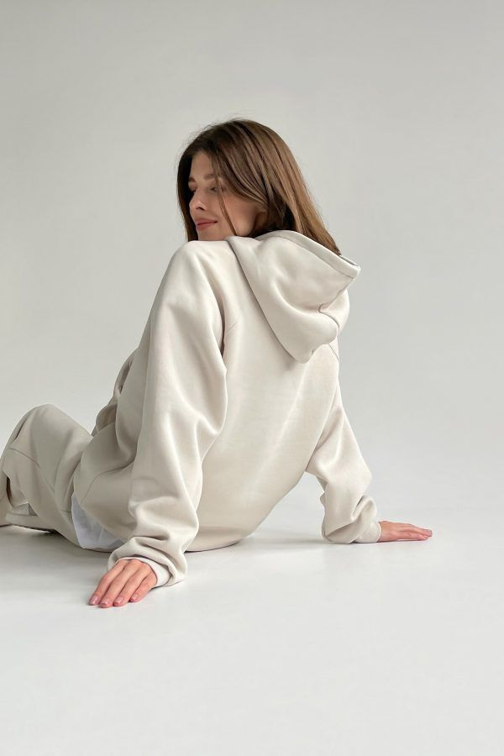
Clothing Presentation
Materials That Matter
Choosing the appropriate materials greatly impacts both comfort and durability, ultimately defining the overall wearing experience.
@stylesaura

Slide 5
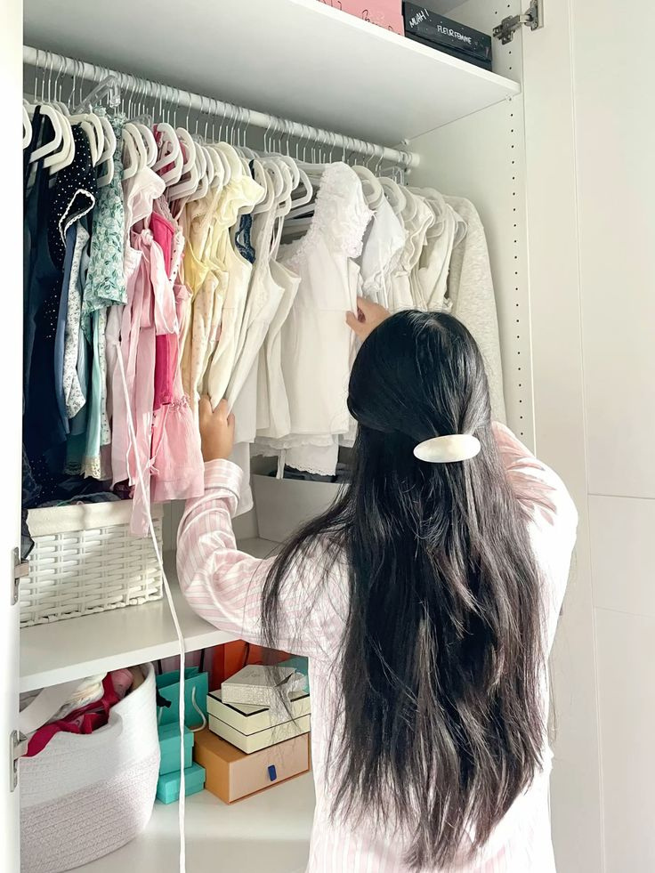
Functional Designs
Concealed Assistance
Strategic construction methods enhance comfort while maintaining the exterior appearance.
Intelligent Insights
Intuitive Components
Details such as easy closures and flexible seams enhance usability by eliminating minor obstacles.
Daily Resilience
Reinforced elements are designed to endure continuous movement and regular usage.

Slide 6
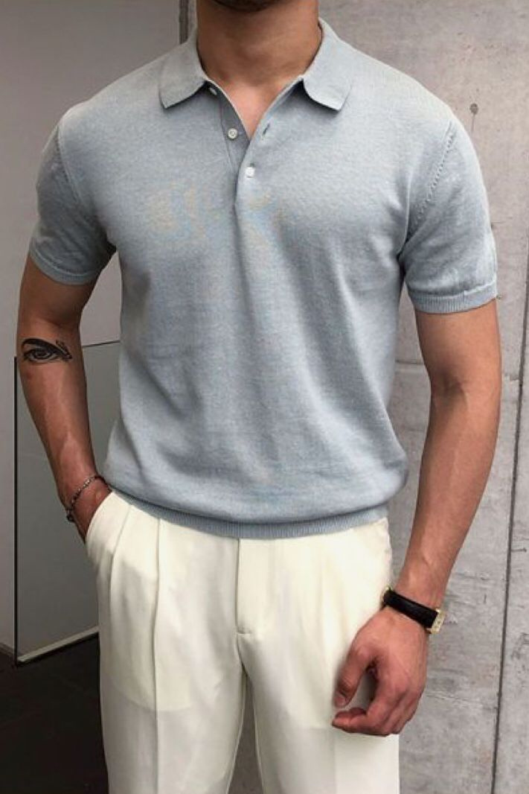


Clothing Presentation
Building a Coordinated Wardrobe
Style Cohesion
Coordinated wardrobes enable individuals to mix and match outfits with ease, minimizing decision-making time and enhancing daily routines.

